Slide 1

18CSO107T- IOS DEVELOPMENT Unit - 2

Slide 2
UNIT – 2 Contents
The Swift Language-Types
Literals and subscripting, Initializers, Web services, Properties, Instance methods
Optionals, Subscripting dictionaries, Loops and String Interpolation, Enumerations
View-Basics, Frames, Customizing the Labels
The Auto-Layout System, Adding Constraints
Text Input- Editing, Keyboard attributes
Dismissing Keywords, number Formatters
Delegation, Conforming to a protocol
View Controller, UITabBarController
Appearing and accessing views

Slide 3
Session 1
The Swift Language-Types
Literals and subscripting, Initializers, Web services, Properties, Instance methods

Slide 4
The Swift Language - Features
Swift - new programming language for iOS, macOS, watchOS, and tvOS app development.
Its code is safe by design, produces software that runs very-fast.
Swift provides its own versions of all fundamental C and Objective-C type
Introduces advanced types, such as tuples, dictionary.
Optional types, which handle the absence of a value
Swift is a type-safe language, which means the language helps you to be clear about the types of values your code can work with

Slide 5
Swift - Basics
Swift uses variables to store and refer to values by an identifying name.
Swift also makes extensive use of variables whose values can’t be changed. These are known as constants
Constants and variables associate a name (such as NumberOfLoginAttempts or welcomeMessage) with a value of a particular type (such as the number 10 or the string "Hello").
The value of a constant can’t be changed once it’s set, whereas a variable can be set to a different value in the future.

Slide 6
Literals
A Literal is the direct value of variable or constant.
It may be a number, character or string.
Literals are used to initialize or assign value to variables or constants.
When the compiler encounters a literal, it attempts to infer the type automatically. It does this by looking for each type that could be initialized by that kind of literal
If no type can be inferred, Swift initializes the default type for that kind of literal — Int for an integer literal, String for a string literal, and so on.
57 // Integer literal
"Hello" // String literal

Slide 7

Declaring Constants and Variables
Constants and variables must be declared before they’re used.
You declare constants with the let keyword and variables with the var keyword.
Example
You can declare multiple constants or multiple variables on a single line, separated by commas:
var x = 0.0, y = 0.0, z = 0.0

Slide 8
Comments
Use comments to include non-executable text in your code.
Comments are ignored by the Swift compiler
Comments in Swift are very similar to comments in C.
Single-line comments begin with two forward-slashes (//):
// This is a comment.
Multiline comments start with a forward-slash followed by an asterisk (/*) and end with an asterisk followed by a forward-slash (*/):
/* This is also a comment
but is written over multiple lines. */

Slide 9
Types in Swift
In Swift, there are two kinds of types: named types and compound types.
A named type is a type that can be given a particular name when it’s defined.
Named types include classes, structures, enumerations, and protocols.
For example, instances of a user-defined class named MyClass have the type MyClass.
The Swift standard library defines many commonly used named types, including those that represent arrays, dictionaries, and optional values.

Slide 10
Types in Swift
Data types - basic or primitive in other languages—such as types that represent numbers, characters, and strings—are actually named types,
They are defined and implemented in the Swift standard library using structures.
Because they’re named types, you can extend their behavior to suit the needs of your program, using an extension declaration.

Slide 11
Types in Swift
A compound type is a type without a name, defined in the Swift language itself.
There are two compound types: function types and tuple types.
A compound type may contain named types and other compound types.
For example, the tuple type (Int, (Int, Int)) contains two elements: The first is the named type Int, and the second is another compound type (Int, Int).
You can put parentheses around a named type or a compound type.

Slide 12
Types in Swift
A function type represents the type of a function, method, or closure and consists of a parameter and return type separated by an arrow (->):
(parameter type) -> return type
The parameter type is comma-separated list of types.
Because the return type can be a tuple type, function types support functions and methods that return multiple values
A function type can have variadic parameters in its parameter type

Slide 13
Types in Swift
Type Aliases
In swift, by using typealiases keyword, we can create a new name for an existing type.
The typealiases are useful whenever we want to create a meaningful name for our existing types.
The syntax of creating an alternative name to the existing type using typealias keyword.
typealias <Name> = <type>
The simple example of using typealias to create an alternative name for the “String” type.
typealias PersonName = String
var Name : PersonName = "Tutlane"
print(Name)

Slide 14
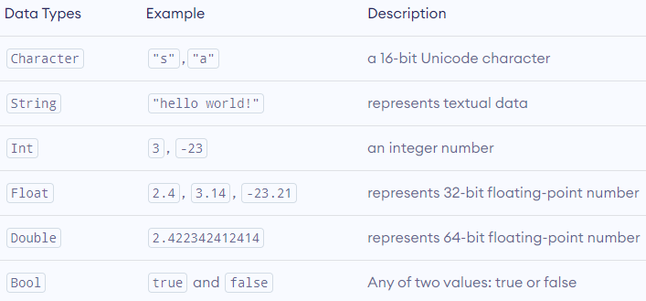
Swift - Basic Data Types

Slide 15
Data Types
Integer
Integers are whole numbers with no fractional component, such as 42 and -23. Integers are either signed (positive, zero, or negative) or unsigned (positive or zero
Swift provides signed and unsigned integers in 8, 16, 32, and 64 bit forms
Always use Int for integer values in your code and Uint for unsigned integers
var num: Int
num =10
Or let num=10

Slide 16
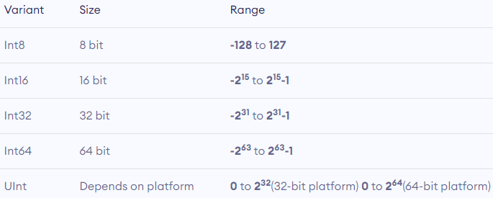
Data Types
Integer
Swift provides different variants of Int type having different sizes.

Slide 17
Data Types
Floating Point
Floating-point numbers are numbers with a fractional component, such as 3.14159, 0.1, and -273.15
Swift provides two signed floating-point number types:
Double represents a 64-bit floating-point number.
Float represents a 32-bit floating-point number.
Range: 1.2 x 10-38 to 3.4 x 1038 (Up to 6 decimal places)
Example
// create float type variable
let piValue: Float = 3.14
print(piValue)
// Output: 3.14

Slide 18
Data Types
Double
A double data type is also used to represent a number with fractional components. However, Double supports data up to 15 decimal places.
We use the Double keyword to create double variables.
Range: 2.3 x 10-308 to 1.7 x 10308 (Up to 15 decimal places)
For example,
// create double type variable
let latitude: Double = 27.7007697012432
print(latitude)
// Output: 27.7007697012432

Slide 19
Data Types
Character
The character data type is used to represent a single-character string.
We use the Character keyword to create character-type variables.
For example,
// create character type variable
var letter: Character = "s"
print(letter)
// Output: s

Slide 20
Data Types
String
The string data type is used to represent textual data.
We use the String keyword to create string-type variables.
For example,
// create string type variable
var language: String = "swift"
print(name)
// Output: swift

Slide 21
Data Types
Boolean
A boolean data type is used to represent logical entities.
It can have one of two values: true or false.
We use the Bool keyword to create boolean-type variables. If we don't assign any value to a boolean variable, it takes false as its default value.
For example,
// create boolean type variable
let passCheck: Bool = true
print(passCheck)
let failCheck: Bool = false
print(failCheck)

Slide 22
Type Casting
It is about converting one type to another
You can convert the integer value to a float value and vice-versa. Consider the ex ample below:
let a: Int = 5679 // Declare 2 constants
let b: Float = 2.9999//Converting Float to Int print("This number is an Int now \(Int(b))") //Converting Int to Float
print("This number is a Float now \(Float(a))")
Output:
This number is an Int now 2
This number is a Float now 5679.0

Slide 23
Properties
A property is a value associated with an instance of a type.
Two types: Stored and Computed
Stored properties store constant and variable values as part of an instance, whereas computed properties calculate (rather than store) a value.
Computed properties are provided by classes, structures, and enumerations.
Stored properties are provided only by classes and structures.

Slide 24
Stored Properties
Stored properties can be either variable stored properties (introduced by the var keyword) or constant stored properties (introduced by the let keyword).
You can provide a default value for a stored property as part of its definition.
You can also set and modify the initial value for a stored property during initialization.

Slide 25
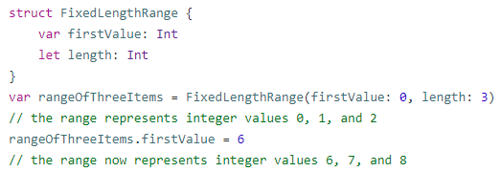
Stored Properties
Example
It defines a structure called FixedLengthRange, which describes a range of integers whose range length can’t be changed after it’s created

Slide 26
Computed Properties
Computed Properties are pieces of code which will calculate a value every time you call them
They are always variables (never constants)
These type of properties can be used in or outside classes, structs, enums
Classes, structures, and enumerations can define computed properties, which don’t actually store a value.
Instead, they provide a getter and an optional setter to retrieve and set other properties and values indirectly.

Slide 27
Defining a computed property
Create a variable and explicitly declare the type of the property to help the compiler know what kind of value will be assigned to it.
Do not assign a default value. Instead open a bracket after the type declaration and start working on the getter.
As the value of the variable is set and retrieved through the use of setters and getters, you need to at least use the getter inside the brackets as below:

Slide 28
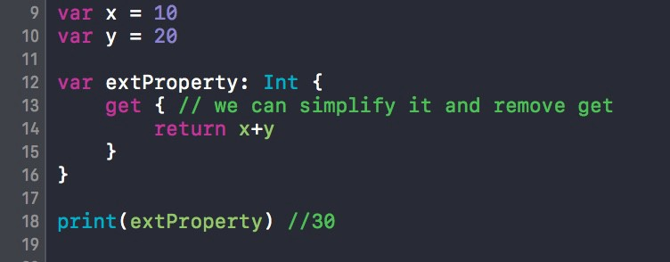
Defining a computed property
You can see a computed property of type Int, and inside its brackets I am using a getter to return the result of x+y

Slide 29
Defining a computed property
Once the computed property is called the getter gets executed and the variable is assigned the result
Using get { }
The get keyword makes the computed property readable
A getter allows you to read data from the computed property
Inside the brackets you write the code that will be executed once the computed property is called
Accessing the property executes the getter

Slide 30
Defining a computed property
Using set { }
The set keyword makes the computed property writeable. Without it you get this error: Cannot assign to value [your computed property’s name], it is a get-only property.
When you assign a value to the computed property you are calling the setter
The value is accessible inside the setter’s brackets
You cannot assign a value to a computed property that doesn’t have a setter.

Slide 31
Defining a computed property
You can assign a local name inside the parentheses after the set keyword. This local variable will get the passed value to the computed property (as seen in the example below with newSalaryPerWeek)
If you do not provide a name for the assigned value in the setter definition, the compiler will automatically allocate the name of newValue.

Slide 32
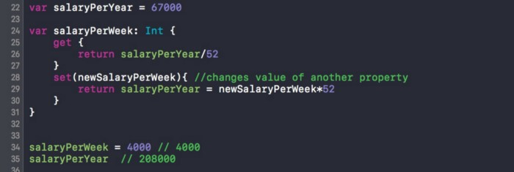
Defining a computed property

Slide 33
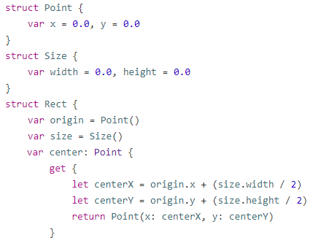
Computed Properties in Structures
Example

Slide 34
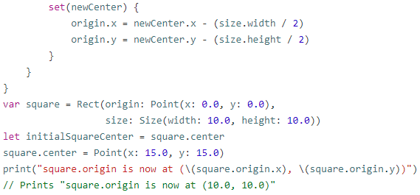
Computed Properties
Example (Conti…)

Slide 35
Initializers
So far, you have initialized your constants and variables using literal values. In doing so, you created instances of a specific type.
An instance is a particular embodiment of a type.
Another way of creating instances is by using an initializer on the type
Initialization is the process of preparing an instance of a class, structure, or enumeration for use.
To create a new instance using an initializer, you use the type name followed by a pair of parentheses and, if required, arguments.

Slide 36
Initializers
Some standard types have initializers that return empty literals when no arguments are supplied.
let emptyString = String() //"“
let emptyArrayOfInts = [Int]() //0 elements
Initializers are responsible for preparing the contents of a new instance of a type.
In its simplest form, an initializer is like an instance method with no parameters, written using the init keyword:
init() {
// perform some initialization here
}

Slide 37
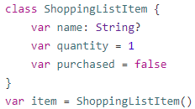
Default Initializers
Some types have default values
let defaultNumber = Int() //0
let defaultBool = Bool() //false.
The default initializer simply creates a new instance with all of its properties set to their default values.

Slide 38
Multiple Initializers
Types can have multiple initializers.
For example, String has an initializer that accepts an Int and creates a string based on that value.
let number = 42 //42
let meaningOfLife = String(number) //"42“

Slide 39
Instance Methods
An instance method is a function that is specific to a particular type and can be called on an instance of that type.
Classes, structures, and enumerations can all define instance methods, which encapsulate specific tasks and functionality for working with an instance of a given type.
In Swift, you can choose whether to define a class, structure, or enumeration, and still have the flexibility to define methods on the type you create.

Slide 40
Instance Methods
Example
var countingUp = ["one", "two"] //["one", "two"]
let secondElement = countingUp[1] // "two"
countingUp.count
countingUp.append("three") //instance method
//["one", "two", "three"]
The append(_:) instance method from Array<T>.
It accepts an element of the array’s type and adds it to the end of the array

Slide 41
Instance Methods
You write an instance method within the opening and closing braces of the type it belongs to.
An instance method has implicit access to all other instance methods and properties of that type.
An instance method can be called only on a specific instance of the type it belongs to.
It can’t be called in isolation without an existing instance.
An example that defines a simple Counter class, which can be used to count the number of times an action occurs:

Slide 42
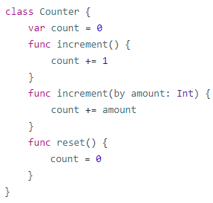
Instance Methods
The Counter class defines three instance methods:
increment() increments the counter by 1.
increment(by: Int) increments the counter by a specified integer amount.
reset() resets the counter to zero.

Slide 43
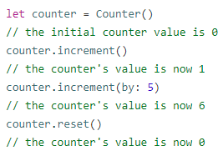
Instance Methods
The Counter class also declares a variable property, count, to keep track of the current counter value.
You call instance methods with the same dot syntax as properties:

Slide 44
The self Property
Every instance of a type has an implicit property called self, which is exactly equivalent to the instance itself.
You use the self property to refer to the current instance within its own instance methods.
func increment() {
self.count += 1
}
If you don’t explicitly write self, Swift assumes that you are referring to a property or method of the current instance whenever you use a known property or method name within a method

Slide 45
The self Property
The main exception to this rule occurs when a parameter name for an instance method has the same name as a property of that instance.
In this situation, the parameter name takes precedence, and it becomes necessary to refer to the property in a more qualified way.
You use the self property to distinguish between the parameter name and the property name.
Here, self disambiguates between a method parameter called x and an instance property that’s also called x:

Slide 46
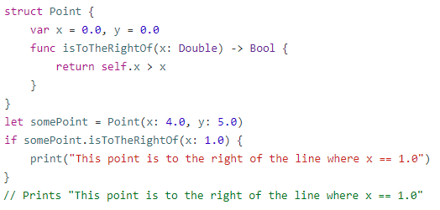
The self Property
Without the self prefix, Swift would assume that both uses of x referred to the method parameter called x.

Slide 47
Session 2
Optionals, Subscripting dictionaries, Loops
String Interpolation

Slide 48
Optionals
You use optionals in situations where a value may be absent.
An optional represents two possibilities: Either there is a value, and you can unwrap the optional to access that value, or there isn’t a value at all
The default value is a null value (nil).
You can use optional when you want a variable or constant contain no value in it.
An optional type may contain a value or absent a value (a null value).

Slide 49
Optionals
Declaring Optionals
You can simply represent a Data type as Optional by appending ! or ? to the Type.
If an optional contains a value in it, it returns value as Optional<Value>, if not it returns nil.
Example
var serverResponseCode: Int? = 404
// serverResponseCode contains an actual Int value
of 404
serverResponseCode = nil
// serverResponseCode now contains no value

Slide 50
Optionals
Optional Example
var someValue:Int?
var someAnotherValue:Int!
print(someValue)
print(someAnotherValue)
The output will be:
nil
nil
Declaring an optional Int means the variable will either have an integer value or no value.
Since no value is assigned to the variable, you can see both print statement outputs nil on the screen

Slide 51
Optionals
Optional Example
let someValue:Int? = 5
print(someValue)
print(someValue!)
The output will be:
Optional(5)
5
As you can see, printing the optional as print(someValue) doesn't give you 5 but Optional(5).
It is of the form as described above: Optional<Value>.
In order to access the <Value> from it, we need a mechanism called unwrapping.

Slide 52
Optionals
Optional Example
You can unwrap an optional by appending ! character at the end of the variable/constant as in the next line print(someValue!).
print(someValue!) unwraps the optional and outputs 5 on the screen.
However, remember, this kind of unwrapping mechanism should only be used when you are certain that the optional will sure have a value when you access it.

Slide 53
Optionals
Explicitly declaring an unwrapped optional
You can also create an unwrapped optional as:
let someValue:Int! = 5
print(someValue)
The output will be:
5
Int! creates a unwrapped optional, which automatically unwraps the value while you access it so that you don't need to everytime append the ! character.

Slide 54
Optionals
Fatal error when accessing a null unwrapped optional
var someValue:Int!
var unwrappedValue:Int = someValue
//crashes due to this line
When you run the program, you will get a crash as fatal error: unexpectedly found nil while unwrapping an Optional value because the code unwrappedValue:Int = someValue tries to assign value from Optional someValue to variable unwrappedValue.
However, somevalue is an Optional type that contains nil value. Trying to assign nil value to variable unwrappedValue which is not an optional will lead to crash.

Slide 55
Optionals
Optional Handling
In order to use value of an optional, it needs to be unwrapped. Better way to use optional value is by conditional unwrapping rather than force unwrapping using ! operator.
This is because conditionally unwrapping asks Check if this variable has a value?. If yes, give the value, otherwise it will handle the nil case.
Force unwrapping says This variable does have a value while you use it. Therefore, when you force unwrap a variable that is nil, your program will throw an unexpectedly found nil while unwrapping an optional exception and crash.

Slide 56
Optionals
Optional Binding (if-let)
Optional binding helps you to find out whether an optional contains a value or not.
If an optional contains a value, that value is available as a temporary constant or variable.
Therefore, optional binding can be used with if statement to check for a value inside an optional, and to extract that value into a constant or variable in a single action.

Slide 57
Optionals
Optional Binding (if-let) Example
var someValue:Int?
var someAnotherValue:Int! = 0
if let temp = someValue {
print("It has some value \(temp)")
} else {
print("doesn't contain value")
}
if let temp = someAnotherValue {
print("It has some value \(temp)")
The output will be:
doesn't contain value
It has some value 0

Slide 58
Optionals
Optional Binding (if-let) Example
In the above program, the code inside if statement executes if the optional contains a value.
Otherwise the else block gets executed.
The if-let statement also automatically unwraps the value and places the unwrapped value in temp constant.
This technique has major advantage because you don't need to forcibly unwrap the value although being certain an optional contains a value.

Slide 59
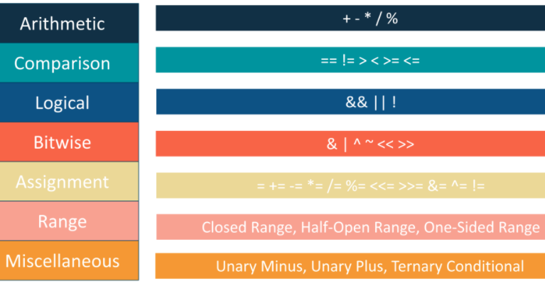
Swift – Operators
An operator is special symbol used to check, change or combine values. It tells the compiler to perform specific mathematical or logical manipulations.

Slide 60
String Operations
The String class in Swift provides various built-in functions that allow us to perform different operations on strings.
1. Compare Two Strings
We use the == operator to compare two strings.
If two strings are equal, the operator returns true.
Otherwise, it returns false.
let str1 = "Hello, world!"
let str2 = "I love Swift."
Let str3 = "Hello, world!"
// compare str1 and str2
print(str1 == str2) Output
// compare str1 and str3 false
print(str1 == str3) true

Slide 61
String Operations
2. Join two strings
We use the append() function to join two strings in Swift. For example,
var greet = "Hello "
var name = "Jack"
// using the append() method
greet.append(name)
print(greet) Output: Hello Jack
We can also use the + and += operators to concatenate two strings.

Slide 62
String Operations
var greet = "Hello, "
let name = "Jack"
// using + operator
var result = greet + name
print(result)
//using =+ operator
greet += name
print(greet)
Output
Hello, Jack
Hello, Jack

Slide 63
String Operations
3. Find Length of String
We use the count property to find the length of a string.
For example,
let message = "Hello, World!"
// count length of a string
print(message.count) // 13
The count property counts the total number of characters in a string including whitespaces.

Slide 64
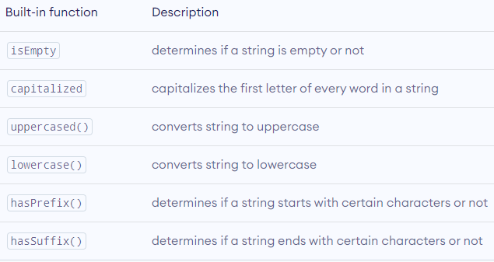
Other Built-in String Operations

Slide 65
String Operations
String Interpolation
We can use the backslash character \ to use variables and constants inside a string. For example,
let name = "Swift"
var message = "This is \(name) programming."
print(message)
Output
This is Swift programming.
Here, we are using the name variable inside the string message.
This process is called String Interpolation in Swift.

Slide 66
Multiline String
We can also create a multiline string in Swift. For this, we use triple double quotes """. For example,
// multiline string
var str: String = """
Swift is awesome
I love Swift
"""
print(str)
Output
Swift is awesome
I love Swift.
Anything inside the enclosing triple-quotes is one multiline string.

Slide 67
Conditional Statements
Conditional statements are used to execute a statement or a group of statements when some condition is true.
There are namely three conditional statements - if, if-else, and switch statements.
An if statement could be either just a simple if, or a nested if statement.
So, a simple if statement is the most simple decision-making statement that decides whether a certain statement or block of statements will be executed or not.

Slide 68
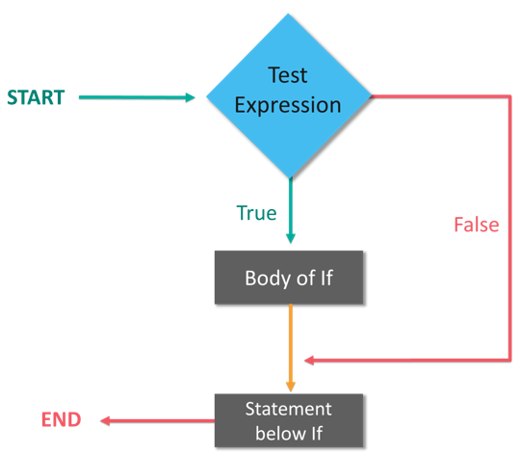
IF Statement

Slide 69
IF Statement
Example
var x:Int = 10
if x < 20
{
print("x is less than 20")
}
print("Value of variable x is \(x)")
Output:
x is less than 20
Value of variable x is 10

Slide 70
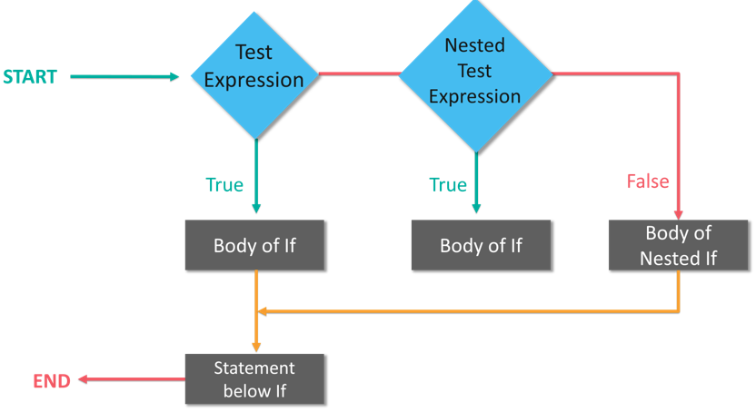
Nested-IF Statement

Slide 71
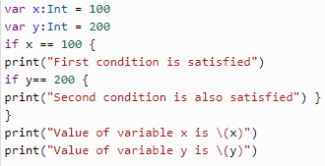

Nested-IF Statement
Example
Output

Slide 72
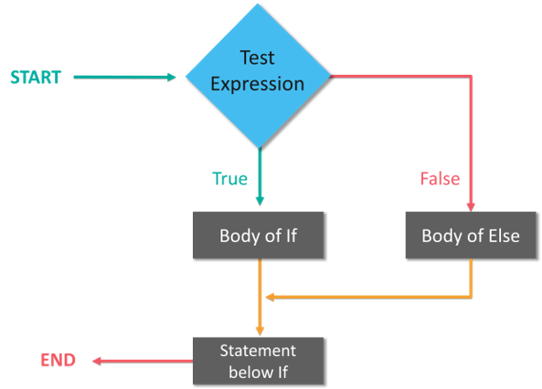
IF – Else Statement

Slide 73

If-else Statement
Example
Output
x is less than 20

Slide 74
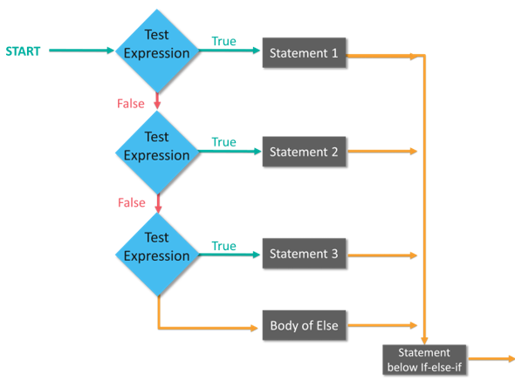
If-else..if-else (If-else ladder)

Slide 75
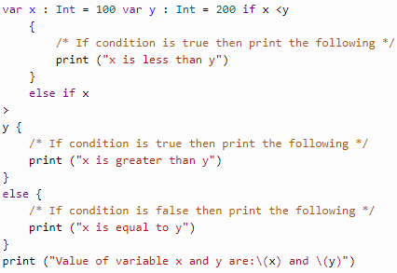
If-else..if-else (If-else ladder)
Example
Output
x is less than y
Value of variable x and y are: 100 and 200

Slide 76
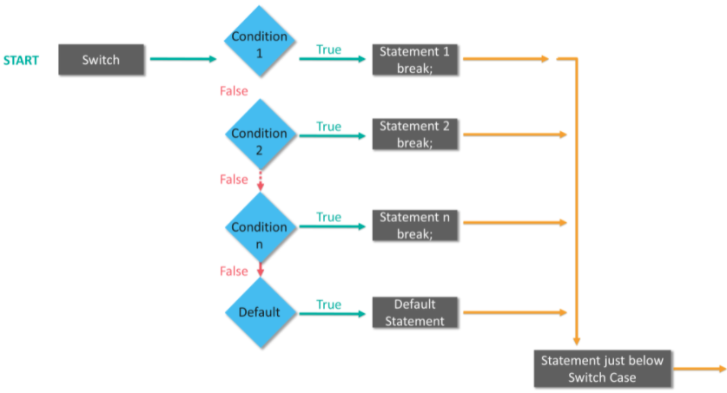
Switch statement

Slide 77
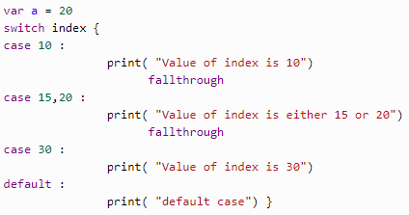
Switch - Case statement
Example
Output
Value of index is either 15 or 20
Value of index is 30

Slide 78
Iterative Loops
There may be a situation when you need to execute a block of code several times.
A loop statement allows us to execute a statement or group of statements multiple times.
So, iterative loops are mainly for-in, while and do-while loops.

Slide 79
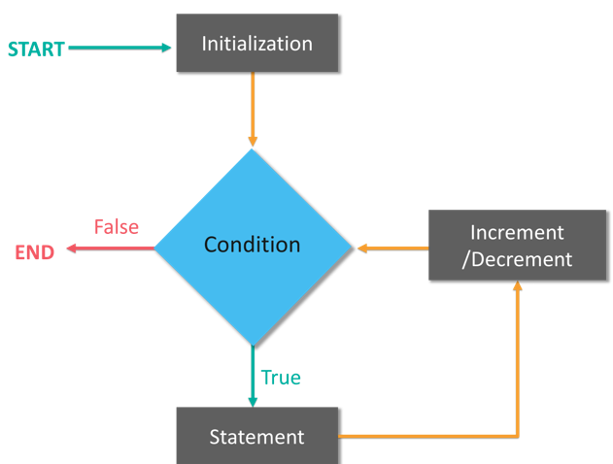
For - in Loop
The for-in loop iterates over collections of items, such as ranges of numbers, items in an array, or characters in a string.

Slide 80


For - in Loop
Example
Output

Slide 81
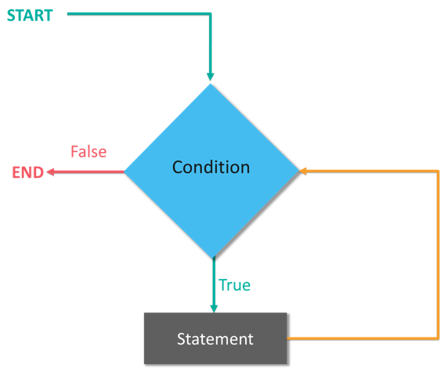
While Loop
A while loop statement executes the target statement(s) as long as a given condition is true.

Slide 82
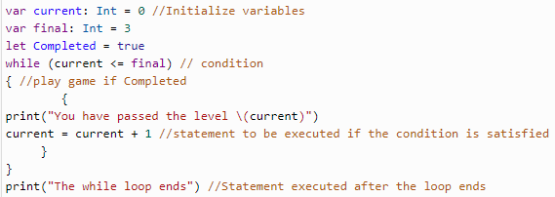

While Loop
Example
Output

Slide 83
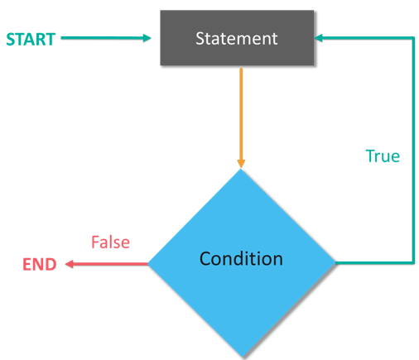
do-while/repeat while Loop
Unlike for and while loops, which test the loop condition at the top of the loop, the repeat...while loop checks its condition at the bottom of the loop.

Slide 84


do-while/repeat while Loop
Example
Output

Slide 85
Arrays and Tuples
Arrays are useful to store the same data type of multiple values in an ordered manner.
In array, we can store the same value in multiple times at different positions based on our requirements.
By using index we can access arrays elements and perform update or delete operations on array elements based on our requirements in swift programming language.
In swift, we can create arrays by surround a list of comma-separated values with square brackets.
// An array of integer elements
var numbers = [1, 2, 3, 4]

Slide 86
Subscripts & Arrays
Accessing Array Elements
we can access array elements by using index positions. Generally in arrays index position will start from zero (0).
Following is the example of accessing array elements using index positions.
var names = ["suresh", "rohini", "praveen", "sateesh"]
print(names)
print(names[0])
print(names[1])
print(names[2])
print(names[3])
The array index is also called as Subscripts

Slide 87
Subscripts
Subscripts
Subscript is a shorter way to access the elements in an array, dictionaries and etc.
We can define the subscripts in classes, structures and enumerations.
Using subscripts, we can directly access or set the value by using index without need of any special methods.
By using subscripts we can call a specific member of array instance like ArrayName[index] same way we can access the elements in dictionary instance like DictionaryName[index].

Slide 88
Subscripts
To define subscript in swift we use subscript keyword and specify one or more input parameters and return type based on our requirements.
Following is the syntax of defining subscripts in swift programming language.
subscript(parameterName:datatype) -> ReturnType {
get {
// return value
}
set (newValue) {
// set value
}
}

Slide 89
Subscripts
We used getter & setter properties to define whether subscript is read-write or ready-only.
The type of newValue must be same as return value of subscript and we have an option not to specify setter parameter (newValue) value.
In that case, the default parameter called newValue will be provided to the setter.
To define read-only subscript in swift, we need to remove getter and setter properties like as shown below syntax.
subscript(parameterName:datatype) -> ReturnType {
// set appropriate value

Slide 90
Subscripts Example
struct addition {
let adds: Int
subscript(i: Int) -> Int {
return adds + i
}
}
let insAdd = addition(adds: 45)
print("Subscript Value: \(insAdd[3])")
We created an instance for structure addition and sending initial value.
We are querying structure instance by calling its subscript.

Slide 91
Subscripts Example
struct addition {
let adds: Int
subscript(i: Int) -> Int {
return adds + i
}
}
let insAdd = addition(adds: 45)
print("Subscript Value: \(insAdd[3])")
We created an instance for structure addition and sending initial value.
We are querying structure instance by calling its subscript.

Slide 92

Tuple
Tuples are used to group multiple values in a single compound value.
Example
Output
The code is 404
The definition of error is Gateway not found
404

Slide 93
Sets
Sets are used to store distinct values of same types, without having any definite ordering as that of arrays.
So, you can use sets instead of arrays if you want to ensure that there are no duplicate values or if the ordering of elements is not an issue.
A Set is created by placing all the items (elements) inside braces [], separated by a comma. Consider the example below:
let evenNumber: Set = [2,4,6,8,12]
you can also perform the set operations such as Union, Intersection, Subtraction.

Slide 94
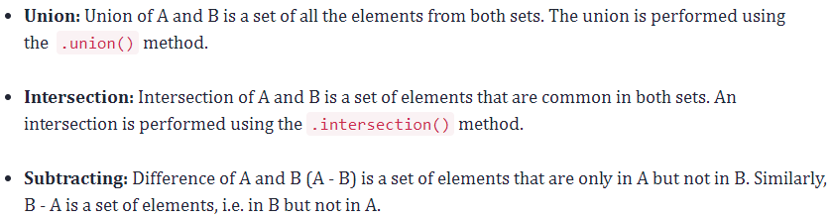
Sets

Slide 95
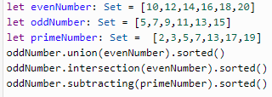

Sets
Example
Output

Slide 96

Functions
A function is basically a set of statements organized together to perform a specific task.
You can call a function, have a function with/without parameters, have a function with/without return values, have function types, and also use nested functions.
Output
Sayantini
Kislay

Slide 97
Closures
Closures generally confuse everyone, but they are just self-contained code, like functions organized as blocks.
They can be anonymous whereas a function has to have a function name. Consider the example below.
let name = { print("Welcome to Swift Closures") } name()
Output
Welcome to Closures

Slide 98
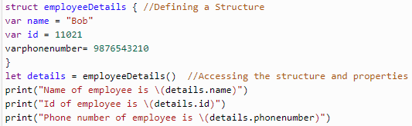

Structures
By making use of structures once, you can define constructs, methods and properties
Output

Slide 99
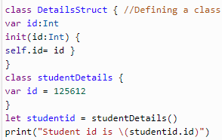
Classes
Classes in Swift are basically the building blocks of flexible constructs.
So, similar to constants, variables, and functions the user can define class properties and methods.
Output
Student id is 125612

Slide 100
Inheritance
Inheritance is the process of creating new classes from existing classes. The derived class (Child) inherits all the capabilities of the base class (Parent) and can add its own functionalities too.
Subclass: If a class inherits properties, methods, and functions from another class, then it is called a subclass. It is also called as Child or Derived class
Superclass: A class which contains properties, methods, and functions to let the other classes inherit from itself is called a superclass. It is also called as Base class or Parent Class

Slide 101
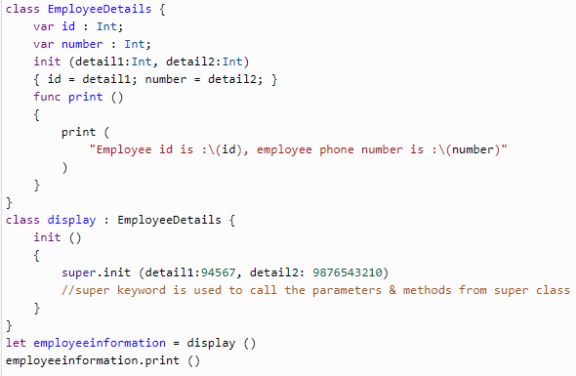
Inheritance
Output
Employee id is 94567, employee phone number is 9876543210

Slide 102
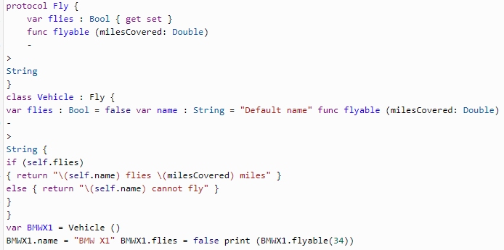
Protocols
Protocols are like interfaces in other languages for methods, properties, and other requirement functionalities
Output BMW X1 cannot fly

Slide 103
Extensions
Extensions are basically used to add the functionalities of an existing class, structure, or enumeration type.
With extensions, you can add computed properties and computed type properties, define and use new nested types, define instance and type methods, provide new initializers, define subscripts, and also make an existing type conform to a protocol.

Slide 104
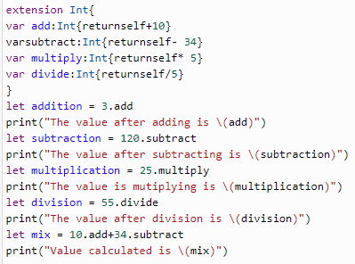

Extensions
Example
Output

Slide 105
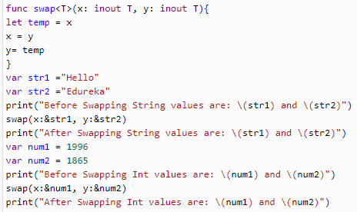

Generics
Generic types are used to write flexible and reusable functions and types. So, bascially, you can use generics to avoid duplication.
Output

Slide 106
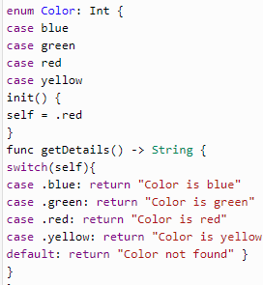
Enumerations
An enumeration is a user-defined data type which consists of a set of related values. The keyword enum is used to define the enumerated data type.

Slide 107
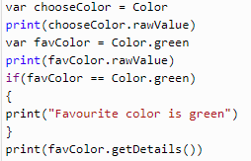
Enumerations
Output
2
1
Favourite color is green
green

Slide 108
Subscripting Dictionaries
Subscripting an array beyond its bounds causes a trap.
The result of subscripting a dictionary is an optional
let nameByParkingSpace = [13: "Alice", 27: "Bob"]
//[13: "Alice", 27: "Bob"]
let space13Assignee: String? = nameByParkingSpace[13] //"Alice"
let space42Assignee: String? = nameByParkingSpace[42] //nil
If the key is not in the dictionary, the result will be nil
As with other optionals, it is common to use if-let when subscripting a dictionary
if let space13Assignee = nameByParkingSpace[13] {
print("Key 13 is assigned in the dictionary!") }

Slide 109
Subscripting Dictionaries
Consider the Dictionary declaration
var scores = [
"arthur": 42,
"ford": 99
"trillian": 314
]
The scores dictionary has keys of type String and values of type Int. You could say that it associates person names with a score, i.e. Arthur has scored 42 points.
You can now refer to any of the members in this collection by using subscript syntax. With subscript syntax, you can get a value, as well as set it.

Slide 110
Subscripting Dictionaries
Getting and Setting Values
You get a value like this:
let score = scores["arthur"]
print(score)
// Output: 42
You set a value like this:
scores["arthur"] = 101
print(scores["arthur"])
// Output: 101
The scores["arthur"] code is called subscript syntax.
Technically, a subscript is used to access the members of a collection.

Slide 111
Subscripting Dictionaries
A subscript consists of:
A variable or constant, containing a collection, such as scores
2 square brackets [ and ]
A key or index inside the brackets
Like this:
scores["arthur"] = 101
collection[key] = …
In Swift, you can use subscripts for arrays, dictionaries, sets, collections, sequences, and even strings
You can also implement your own subscripts with the subscript function

Slide 112
Subscripting Dictionaries
Take this 2×2 matrix, for example:
let matrix = [
[0, 1],
[3, 0]
]
You can now access the value 3, like this:
let value = matrix[1][0]
print(value)
// Output: 3
In the above code matrix[1][0], we’re using 2 subscripts successively:
[1] is used to get the array [3, 0] from the array matrix
[0] is used to get the integer 3 from the array [3, 0]

Slide 113
End of Session 2

